Slide 1
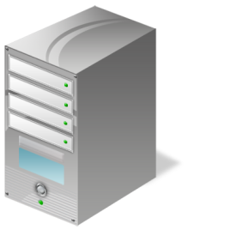
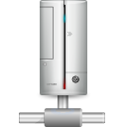
NSIA definition testing framework
Test Case Server
Definition Test Site
The test site hosts tests cases for individual definitions
NSIA Development Instance
@
Website Resources
Definition Test Web Application
Website Resources
The test web application includes a set of pages designed to trigger the definitions. If the definition fails to trigger on the associated resource, the n it has failed the test.
Test
Case
Test
Case
Test
Case
Test
Case
Test
Case
Test
Case
Test
Case

